Slide 1

STORE DATA ANALYSIS

Slide 2

Project Overview
This presentation discusses optimizing the analytics process for the e-commerce company called Olist.
It begins with an overview of the client scenario and scattered data.
The goals are to normalize the data, optimize the ETL process and automate analytics insights.
The presentation describes plans to normalize the data into
tables, extract data from CSV files, transform and clean the
data, and load into the Excel, Tableau, PowerBI and SQL
database for analysis.
It shows how analytical procedures and a dashboard can
provide insights for different aspects.

Slide 3
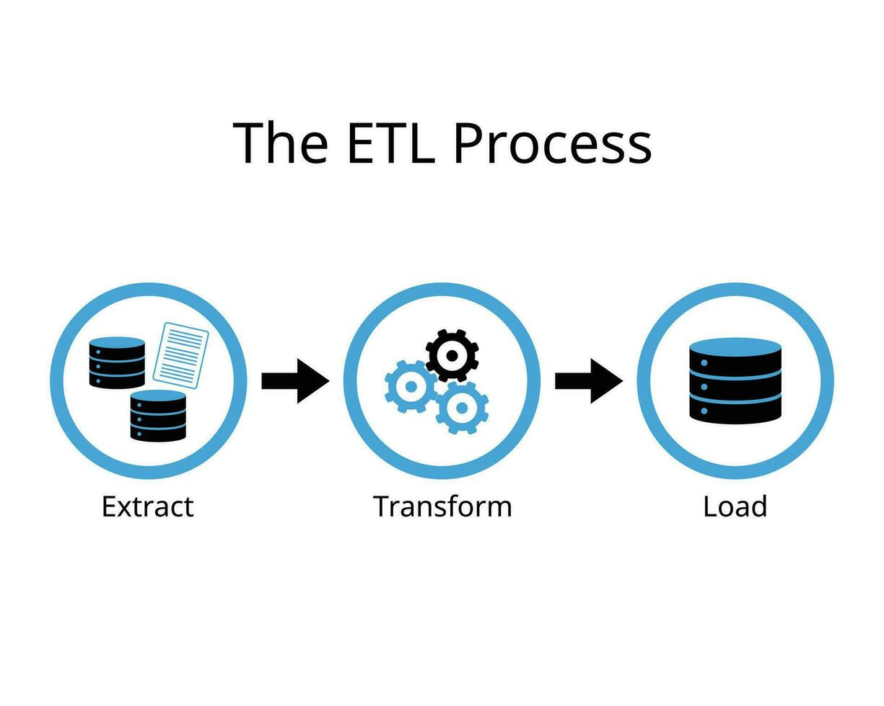
ETL Process
Extract
Transform
Load
Extracting E-Commerce Data from multiple CSV Files.
Performing data cleaning and manipulation on the extracted data
Transforming the data to a destined repository.

Slide 4

Analysis of KPI’s
Weekday Vs Weekend Payment Status.
Payment Type with Review Score 5.
Average number of delivery days taken for “Pet Shop”.
Average Price and Payment Value of Sao Paulo City.
Relation between Review Score and Shipping Days.

Slide 5
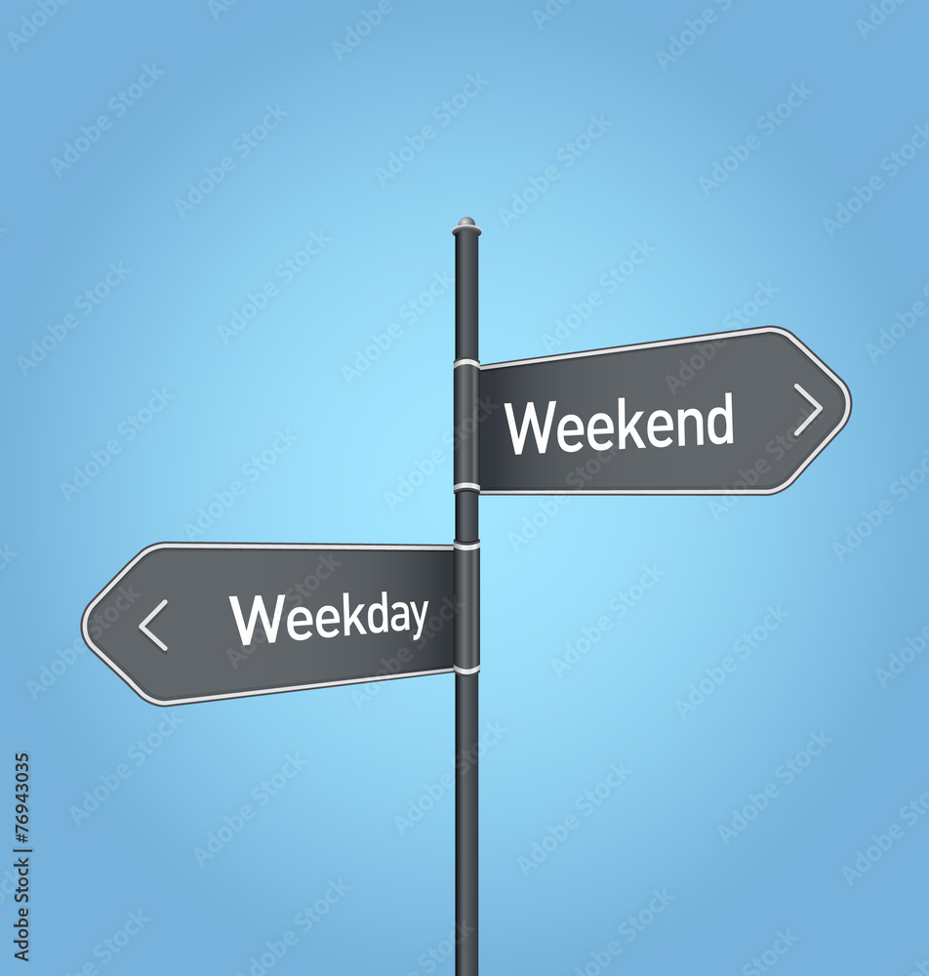
Weekday Vs Weekend Payment Status
Weekday Orders –
Weekday orders show a consistent pattern, with the highest number of purchases occurring during peak hours of the day.
Weekend Orders -
Weekend orders exhibit a more varied pattern, with orders spread throughout the day, indicating different customer behavior.

Slide 6


Payment Type with Review Score 5
High Satisfaction –
A significant percentage of orders with a review score of 5 are associated with credit card payments, indicating customer satisfaction and trust in the payment method.
Customer Loyalty -
This observation aligns with the notion that customers tend to use credit cards for repeat purchases, reflecting loyalty and confidence in the Olist shopping experience

Slide 7

Average Delivery Time for “Pet Shop” Orders
Standard Delivery –
The average number of days taken for order delivery for pet shop items is within an acceptable range, indicating efficient logistics and fulfillment processes.
Customer Expectations –
This data can be used to set realistic delivery time expectations for pet shop customers, enhancing overall satisfaction and trust in Olist's service.

Slide 8

Average Price and Payment Value of Sao Paulo City
Price Analysis –
Customers in Sao Paulo city tend to make purchase of higher average value compared to other regions, reflecting a strong purchasing power and preferences.
Payment Trend –
Credit Card payments are predominant in Sao Paulo, with an average transaction value significantly higher than other payment methods.

Slide 9
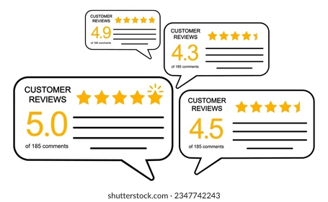

Relationship between Review Score Vs Shipping Days
Customer Satisfaction –
It helps in understanding the impact of delivery time on customer satisfaction levels.
Olist can use this information to optimize their logistics and improve their delivery time.

Slide 10

Conclusion
Insights for Improvement –
Analysis of the KPI’s provides valuable insights for optimizing marketing strategies, logistics, and customer engagement to enhance overall performance.
Trends and Patterns –
Identifying trends in Customer behaviour, payment patterns and regional preferences can drive targeted business decisions and resource allocation.

Slide 11
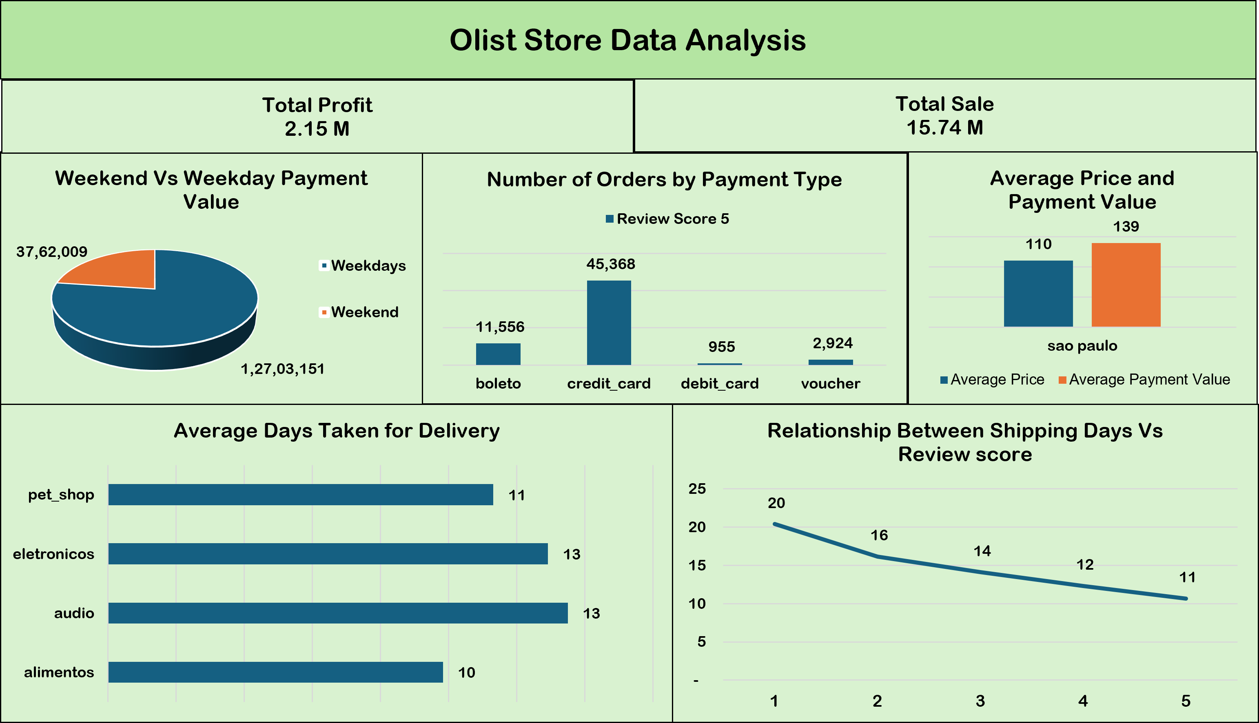
Excel Dashboard

Slide 12
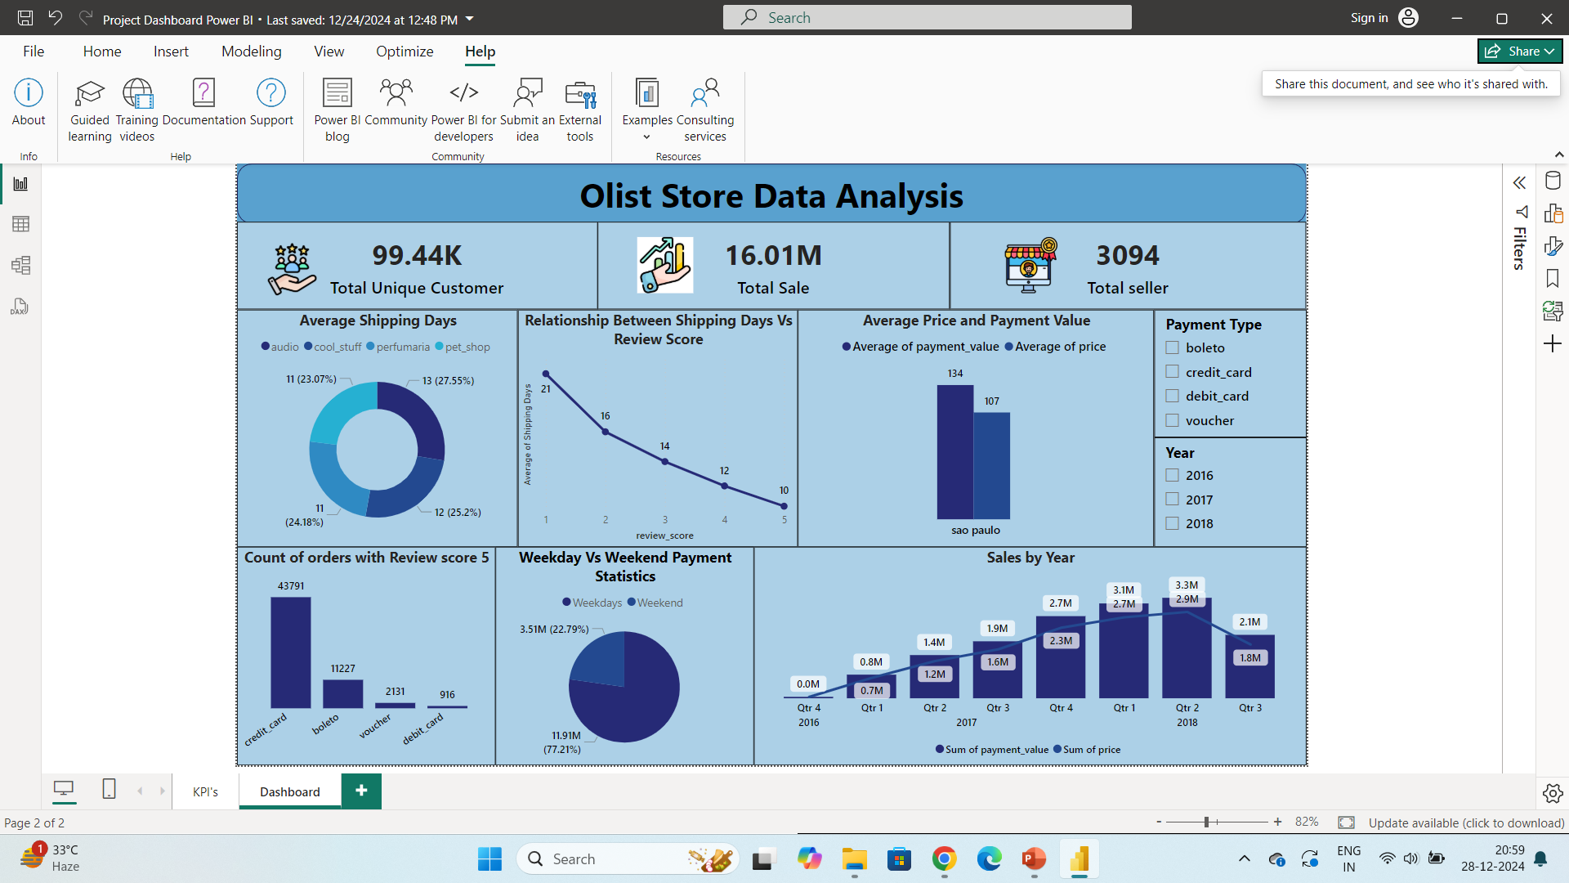
Power BI Dashboard

Slide 13
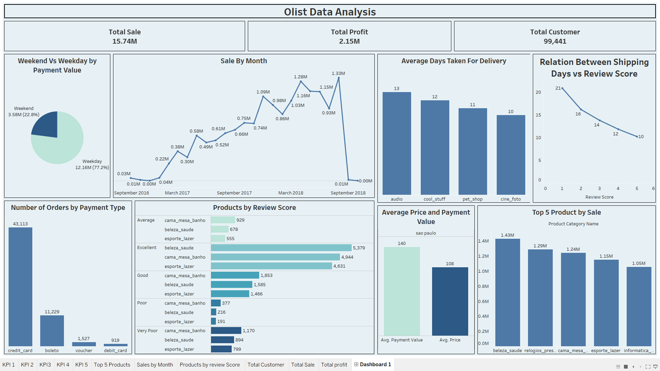
Tableau Dashboard

Slide 14
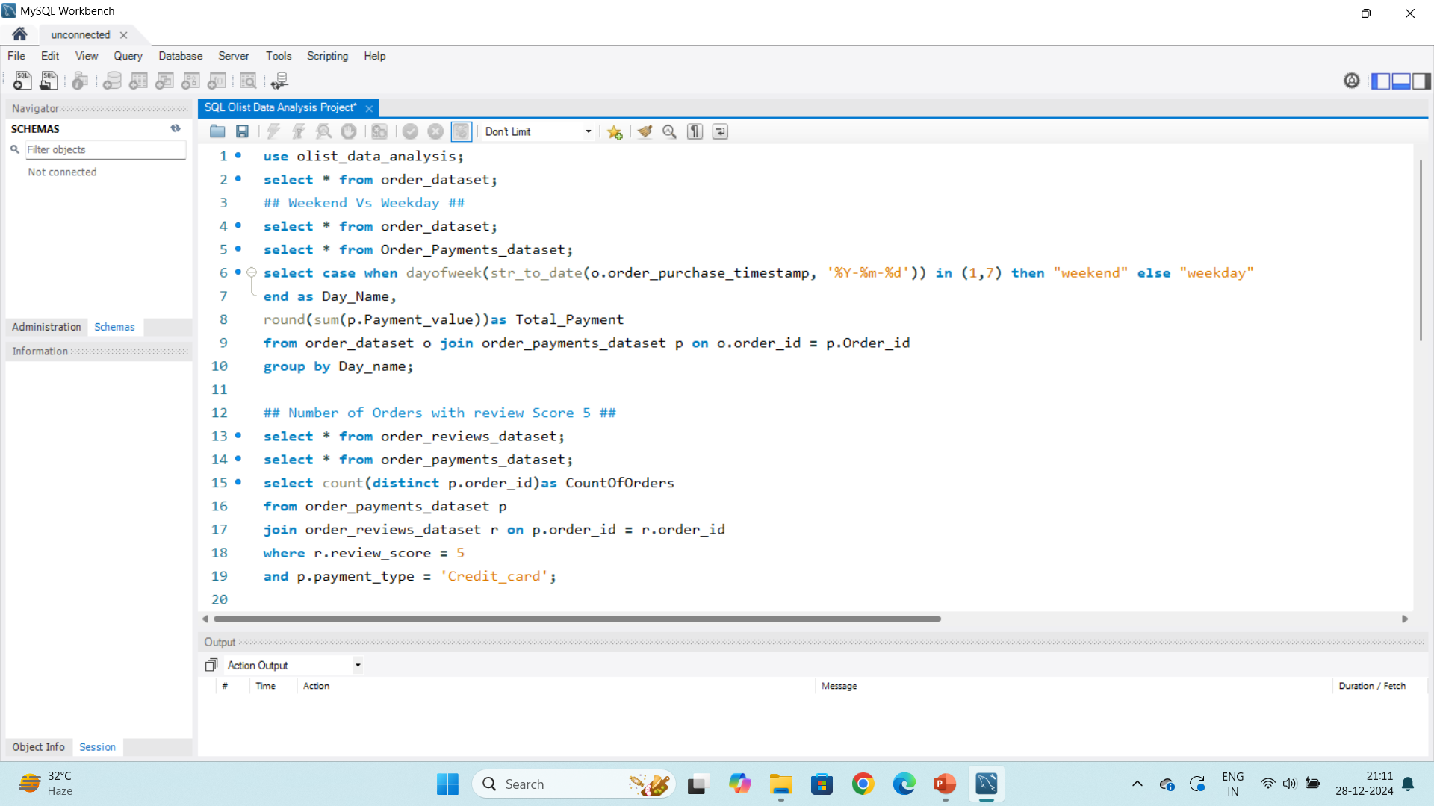
SQL Code Syntax

Slide 15
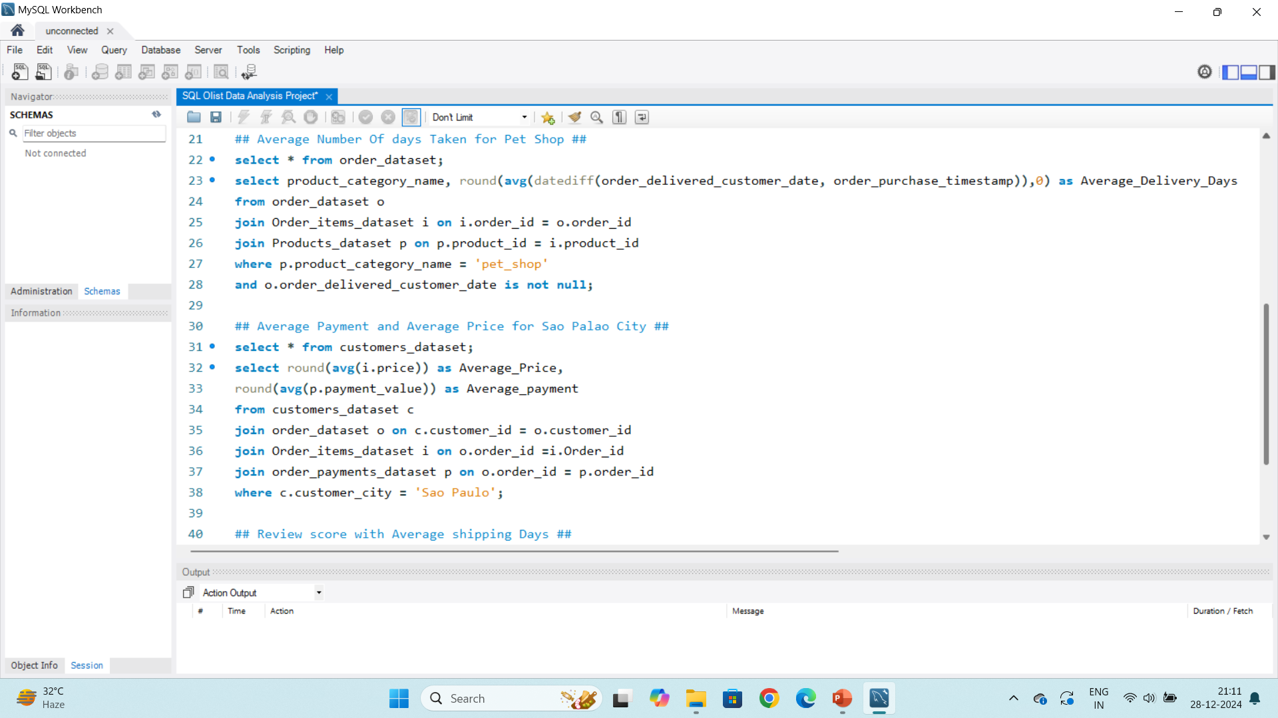
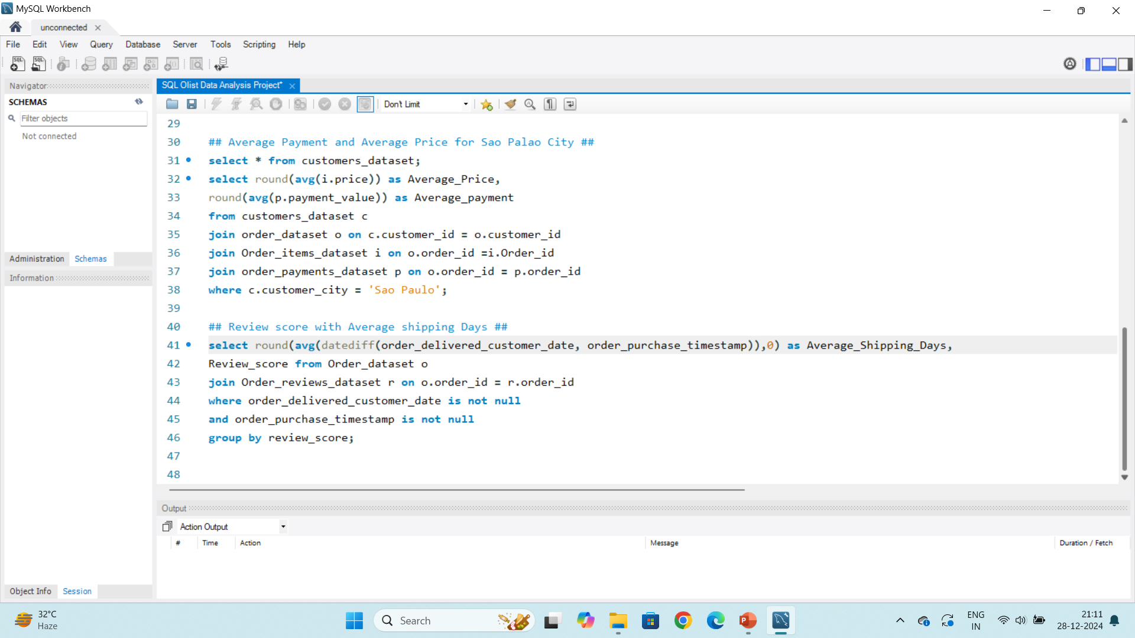

Slide 16


